Slide 1

Let’s Talk About…. The Dangers of Social Media

Slide 2
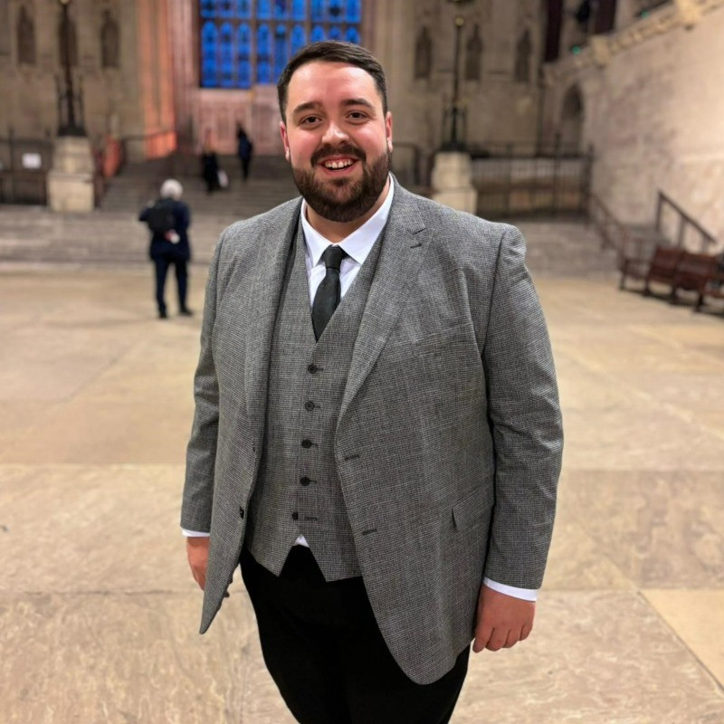

Let’s Talk About…. The Dangers of Social Media
George Warrington
Leah Robinson
We Never Talk About It.
WNTAI is campaigning to raise awareness on the most taboo topics which are happening in young people’s lives.

Slide 3






How many of you in this room are already using….
Let’s Talk About…. The Dangers of Social Media

Slide 4
What are we going to be covering today?
Let’s Talk About…. The Dangers of Social Media
What do you need to know about social media, AI and online gaming?
How can you be respectful & keep yourself safe?
What can you do if you see/hear something inappropriate?

Slide 5
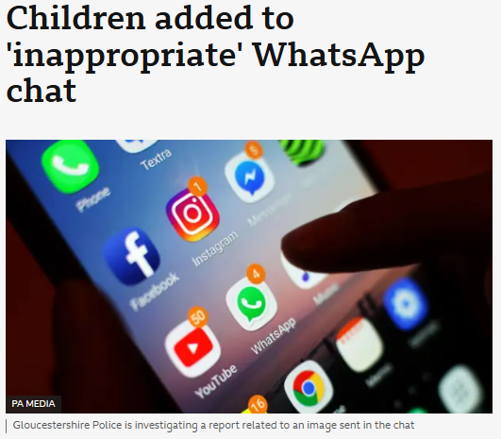
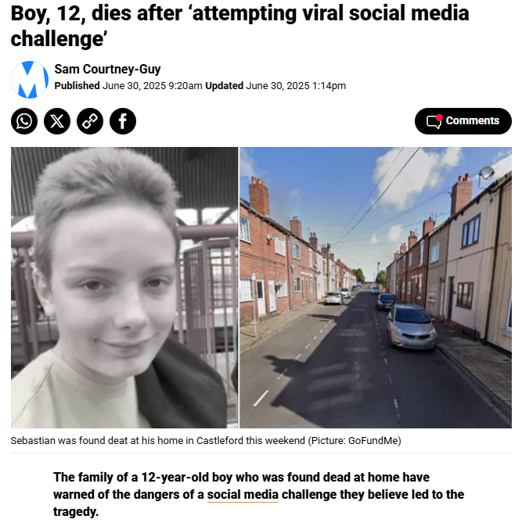
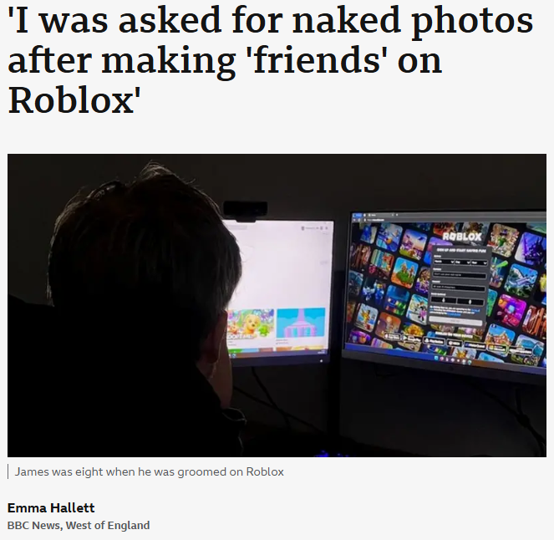
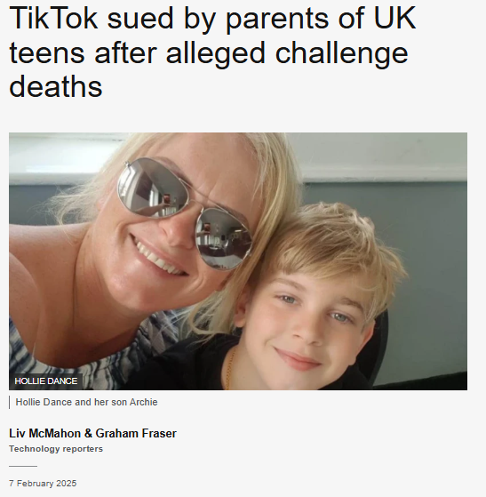
Let’s Talk About…. The Dangers of Social Media

Slide 6

Let’s Talk About…. The Dangers of Social Media
Charley’s Story
Notes:
Charley had friends at school, but didn’t always feel like she would fit in.
Charley started an Instagram page as a fan page for her favourite band which allowed her to make friends with other people with similar interests.
Charley said that when other children at school found her Instagram page they started to be unkind.
Charley was called names such as “emo” and “fat”. She was also told to go and die and to cut herself.
Charley found that people made fake accounts just to give her online abuse about how she looked and how she acted.
Charley was bullied online by people she went to school with but also total strangers.
Some days, Charley found it very hard to go into school due to the bullying she suffered.
Charley didn’t feel like she could talk to anyone about it. She didn’t dare speak to school or her parents about it.
Charley is now 18 and says she still sees day to day how the bullying affected her – she feels self-conscious and worries about others thoughts and judgements on her.
Charley wants to make people realise that words hurt and the impact they can have, even when written online rather than face to face.

Slide 7
Digital Footprint
Let’s Talk About…. The Dangers of Social Media
What do you think makes up your digital footprint?
Data from fitness trackers and smart watches
Voice searches on Alexa or other devices
Information you allow apps to access
Photos and posts on social media
Things you’ve bought online
Games you’ve played online
Comments you’ve made on other people’s posts

Slide 8
Take control of your digital footprint
Let’s Talk About…. The Dangers of Social Media
Check your privacy settings
Control who can see your posts and who can comment on your posts.
You can also control who can search/add you.
Check the data your devices collect
Every device is different so check the settings. Your devices can collect data about you without you realising.
Think before you post
Once you post. it is available for others to see, screenshot and share.
You can delete posts, but these can be recovered.
Set permissions
Be careful what permissions you allow apps to access.
When you visit sites and you’re asked to accept cookies, make sure you check how they will be used before you agree.
Search yourself
Type your name into a search engine to see what information about you is easily available online
Share positive parts of your life
Try sharing things which you are proud of & be supportive when posting comments to other people.

Slide 9
How old do you think you need to be to use these apps?
Let’s Talk About…. The Dangers of Social Media
13+
13+
13+
13+
13+
13+

Slide 10
Why do people post online?
Let’s Talk About…. The Dangers of Social Media
To show how they look
To show what they are doing
To show where they are

Slide 11
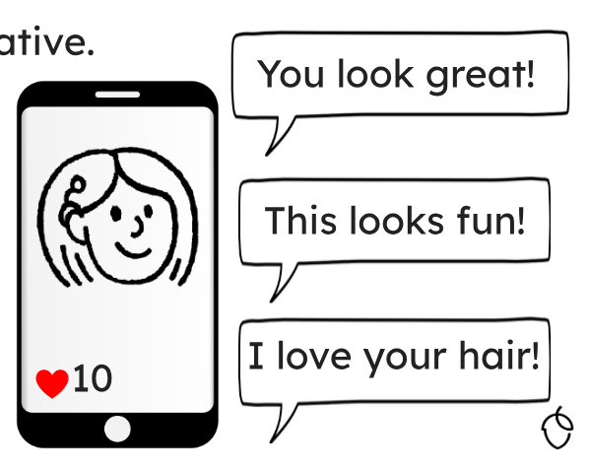

When we post online…
Let’s Talk About…. The Dangers of Social Media
People can like our posts
People can comment
People can share our posts

Slide 12
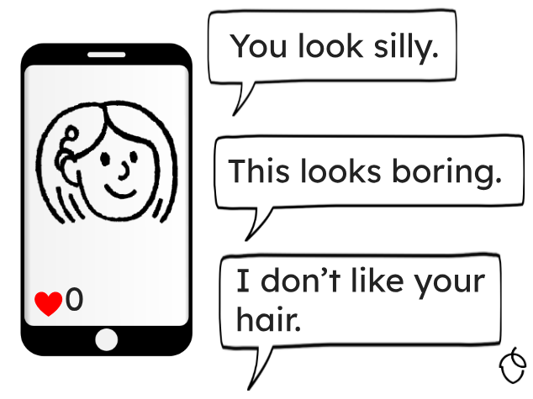
But sometimes, people can be negative…
Let’s Talk About…. The Dangers of Social Media

Slide 13
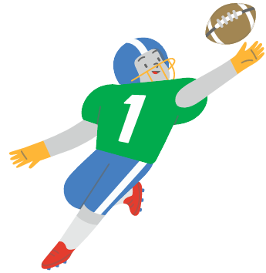


Words matter!
Let’s Talk About…. The Dangers of Social Media
“Awesome”
“Show off”

Slide 14
Top tips for posting: - think about how it will make the person feel - think about whether you are happy to share the information
Let’s Talk About…. The Dangers of Social Media

Slide 15
Remember: Cyberbullying can be a criminal offence in the UK under relevant laws. Sending threatening or abusive messages can lead to an offence of harassment.
Let’s Talk About…. The Dangers of Social Media

Slide 16
What are the risks?
Let’s Talk About…. The Dangers of Social Media
Oversharing
Personal information, like names, phone numbers, links to other social media accounts or their school
Other people's personal information
Links to join private group chats
Photos such as sexual photos or videos.
Sharing your location
Tagging photos with the geo-location
Checking into venues
Sharing journeys
Location settings on devices
Sharing images or videos that contain street names.
Talking to people you don’t know
Message requests on social media.
Online chat rooms and lives.
Gaming and online lobbies.
Sending or receiving inappropriate content
Sharing memes or images.
Forwarding DMs.
Disappearing messages (screenshotting).

Slide 17
Common Acronyms
Let’s Talk About…. The Dangers of Social Media
PAW: Parents are watching.
PITR: Parents in the room.
POMS: Parents over my shoulder.
RN: Right now.
DM: Direct message.
FR: For real.
IMO: In my opinion.
IRL: In real life.
IYKYK: If you know, you know.
KPC: Keeping parents clueless.
PAH: Parent at home.

Slide 18
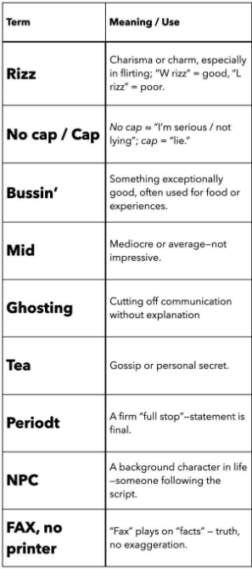
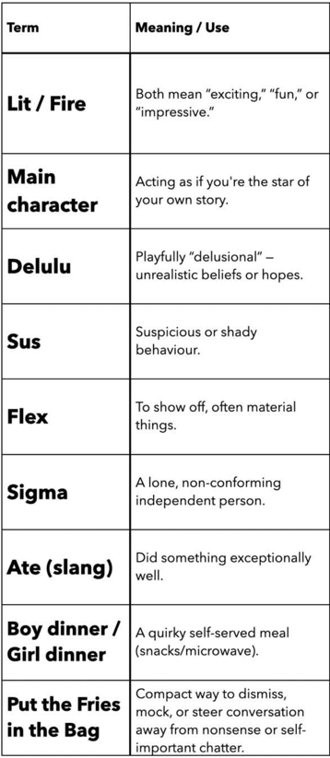




Let’s Talk About…. The Dangers of Social Media
Calling someone a clown means you think they’re a joke, foolish, or fake.
Someone is a snake, meaning a backstabber or traitor.
A frog seems harmless, but in slang it means “ugly”.
A universal insult meaning something is trash or crap.

Slide 19
Misinformation & Disinformation
Let’s Talk About…. The Dangers of Social Media
Misinformation is essentially ‘wrong’ information.
It could be a:
Message or post on social media
Real or edited photo/ video
Website
File or a document
A person might share something online without realising that it’s factually inaccurate or misleading. (Misinformation)
On the other hand, if they deliberately share it to deceive others and get them to believe it, this is known as spreading ‘disinformation’.

Slide 20
Deepfake
Let’s Talk About…. The Dangers of Social Media
A deepfake is an image, video, sound, voice or GIF which has been manipulated
It could have been manipulated without the person’s consent
How to spot a deepfake:
Glitches – Is there blurring on the image/video or is it pixelated?
Audio – does the lip movement not match what you are hearing?

Slide 21
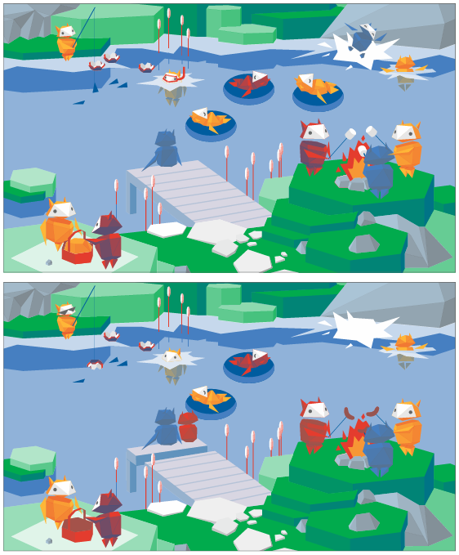
Let’s Talk About…. The Dangers of Social Media
Look at these two pictures… one has been manipulated – can you spot the differences?

Slide 22
Let’s Talk About…. The Dangers of Social Media
Trying to spot disinformation is similar to this spot the difference picture – it is easier if you know what you are looking for…

Slide 23
How to check content you see online?
Let’s Talk About…. The Dangers of Social Media
Ask yourself…
Does the website name seem odd or unfamiliar?
Are there lots of spelling mistakes?
Do you know who has wrote/ created it?
Is the headline shocking or designed to grab attention?
Could this have been made by AI?
Are they being fair or could this be biased?

Slide 24
Don’t believe or share information if you haven’t checked: - where it has come from - whether it is true/fair - whether it will have a negative impact on someone else
Let’s Talk About…. The Dangers of Social Media

Slide 25
Online Gaming
Let’s Talk About…. The Dangers of Social Media
Risks:
Cyberbullying
Inappropriate content
Contact with strangers
Excessive screen time
Spending real money
Exposure to scams
Benefits:
Building skills for life: problem solving, teamwork etc
Social connections
Confidence boost
Healthy competition
Opportunities to learn

Slide 26




How old do you think you need to be to play these games?
Let’s Talk About…. The Dangers of Social Media

Slide 27
Let’s Talk About…. The Dangers of Social Media
7+
12
12
18

Slide 28
Online Gaming
Let’s Talk About…. The Dangers of Social Media
Top Tips:
Check the content of the game and any chat function:
Content within games is regulated and rated into age groups.
There are lots of different age ratings around the world, such as PEGI used in the UK.
Always check the age rating - this is normally visible next to the game title within gaming and app stores.
Consider communication with others:
Consider any communication channels and if there are settings to turn off or limit chat functions.
There can be different types of communications, e.g. group chat or private chat.
Be careful of taking the conversation to other messaging platforms.
Does the game have in-app purchasing?
In-app purchases normally enhance the game or gameplay, for example skins (design of the character or weapon) or loot boxes (treasure chests, but you don’t always know what is in them).
You should consider settings to turn off in-app purchases, or set a spending limit on the device or app.

Slide 29
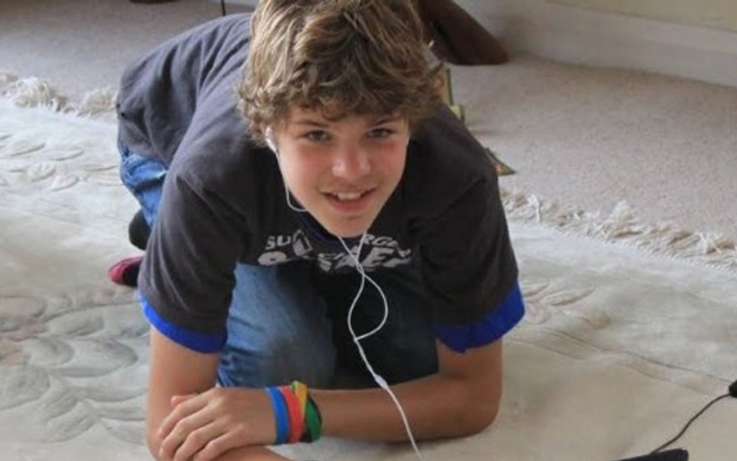
Breck’s story
Let’s Talk About…. The Dangers of Social Media
Notes:
Breck was a 14-year-old boy who was passionate about computing.
Breck enjoyed playing games online with his friends from school.
Whilst gaming with his friends, Breck crossed paths with an 18-year-old called Lewis.
Lewis made up lies about his life to impress Breck and his friends.
Lewis told Breck that he was a millionaire and that he could make Breck rich too through a computer software business that didn’t actually exist.
Breck’s friends started to see through Lewis’ lies and stopped their communication with him, but Breck was being groomed by Lewis and believed everything he said, making Breck turn against his friends.
Breck’s Mum became suspicious of Lewis and limited Breck’s access to his computer and electronics.
Breck’s personality began to change and he became more secretive, keeping information from his family.
Breck’s Mum raised her concerns to the police but nothing was done at the time.
Unfortunately, one day Breck went to meet Lewis in person, but didn’t tell his family. Breck never returned home and lost his life that day at the hands of Lewis.

Slide 30
Helping children to thrive online
Let’s Talk About…. The Dangers of Social Media
1. Apps
What children use matters the most
2. Time
How long children use it matters
You don’t need to control everything.
Focus on what children use and when they use it.

Slide 31
Parental Controls
Let’s Talk About…. The Dangers of Social Media
Did you know…
Apple devices have features available for parents to be able to set privacy restrictions, allow/disallow apps and prevent purchases?
Parental controls can be set up on:
Mobiles, tablet and other devices – each make of device will have its own parental control settings these include location sharing permissions and in app purchases
WiFi and Broadband – use a filter from your internet provider to control the content that you and your family see
Apps – these can be set up through the settings of each app
Game consoles – each console will have different settings where you can turn off in game purchases, restrict games based on age and turn off chat feature

Slide 32
Let’s Talk About…. The Dangers of Social Media
Honest
If your child is telling you about something they have seen/done on social media:
Open
Be understanding and a good listener
Don’t react! – stay calm on the outside
Respect and appreciate your child for telling the truth
Deal with the issue together
Trusting

Slide 33
Questions you can ask:
Let’s Talk About…. The Dangers of Social Media
No question is a wrong question… but questions where you are curious and genuinely interested in what your children are doing can be more helpful than questions where you make assumptions. Some examples of questions you may want to ask are…
How does that post make you feel?
Who shared this content?
Why do you think they posted it?
What kinds of videos do you enjoy watching?
Are there posts you’d like to see less of? Why?

Slide 34
How to build healthy habits
Let’s Talk About…. The Dangers of Social Media
Model safe use of internet with children
Ensure your child knows how to report content that makes them feel uncomfortable
Show how to pause before reacting to content online, deciding whether the content is real or fake
Show children how to fact check information using reliable trusted sources
Spend time each week looking at social media together and discuss what children see

Slide 35
Where to get more help and support:
Let’s Talk About…. The Dangers of Social Media
UK Safer Internet Centre – https://saferinternet.org.uk
Guides for parents about how to keep children safe online, including parental control guides for devices and apps
NSPCC – www.nspcc.org.uk
Guides for parents about how to keep children safe online as well as an advice and support line – 0808 800 5000
CEOP (Child Exploitation and Online Protection – CEOP Safety Centre
Information, advice and support for parents to help keep their child safe online

Slide 36
Places to report:
Let’s Talk About…. The Dangers of Social Media
If you are concerned for a child’s immediate harm, then contact the police on 999
SWGfL – Report Harmful Content – https://reportharmfulcontent.com
IWF (Internet Watch Foundation) – reporting suspected sexual abuse images and videos of children www.iwf.org.uk/en/uk-report
CEOP (Child Exploitation and Online Protection) – reporting concerns about an adult communicating inappropriately with a child www.ceop.police.uk/safety-centre

Slide 37
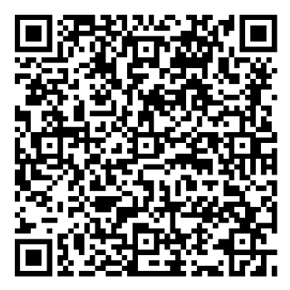
Government’s consultation:
Let’s Talk About…. The Dangers of Social Media
The government are consulting on further measures to prepare children for the future in an age of technological change.
The consultation includes:
potential age restrictions on social media and other services such as gaming sites and AI chatbots
restrictions on addictive design features and risky functionalities
better support for parents and families

Slide 38
Let’s Talk About…. The Dangers of Social Media
Thank you for listening!

