Slide 1

Reception
New Starters Meeting

Slide 2




The School Day
START
FINISH

Slide 3
Attendance
Illness: Please call the attendance before 9am
Holidays: Request a holiday form from the office

Slide 4


Breakfast Club
Open from 8:00am
Children are offered toast or cereal and a drink.
£4 per child

Slide 5

Uniform
Please make sure everything has your child’s name written inside.

Slide 6



What your child will need to bring to school.
A book bag everyday
A waterproof coat
everyday
A water bottle everyday
Please make sure everything has your child’s name on it.

Slide 7
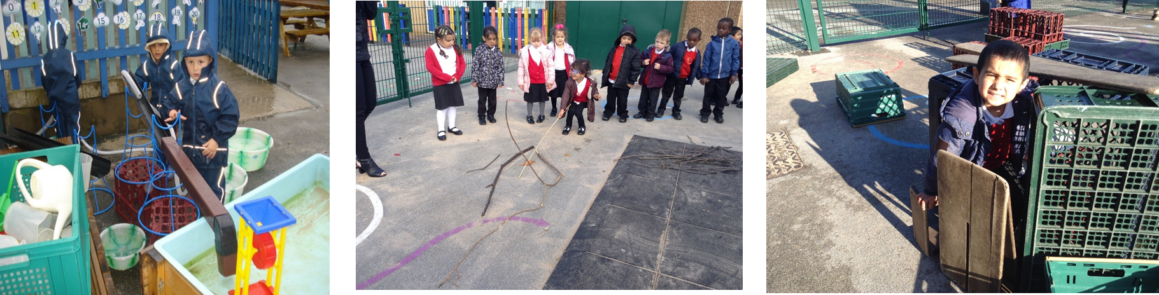
Outdoor Learning
We play outside in all weathers!

Slide 8

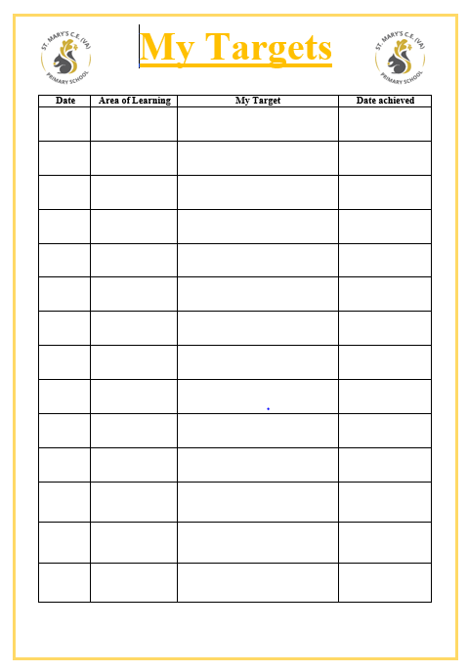
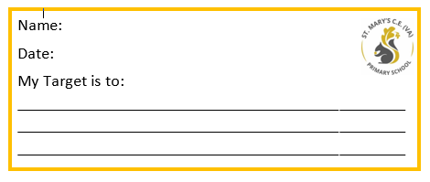
TUESDAY’S
We ask parents/Carers to stay with your child for 10 minutes to read.
THURSDAY’S
We ask parents/Carers to stay with your child for 10 minutes to practise their target.

Slide 9
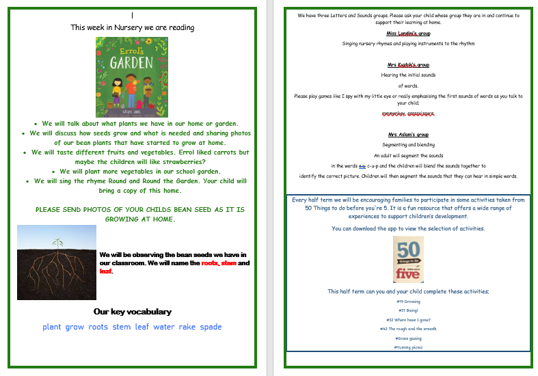
Newsletter
You will receive a weekly newsletter that will inform you about what your child is learning in school and how you can support at home.

Slide 10



Reading Books
Your child will bring home two reading books. One which is linked to their phonic phase and one to read for pleasure for an adult to read to them.
These will be sent home weekly.
There will be a charge of £4:50 for any unreturned or damaged books.

Slide 11

Learning Journals
We pride ourselves in working closely with home.
New parents-You will receive an email asking you to create a password to access your child’s journal.
School will send photographs of ‘wow’ moments to share what your child has been doing in school.
Please send photos from home. These encourage your child to talk about their family and recall past events. We really value this opportunity.

Slide 12

School Dinners
All children from Reception to Year 2 are entitled to free school dinners.
Please support your child to use cutlery.
If your child prefers to being a packed lunch then this must be a healthy lunch.

Slide 13
Early Years Curriculum
By the end of Reception your child will be assessed against 17 Early Learning Goals.
School is ambitious for all children and consider individual needs, interests, and development. We use this information to plan a challenging and enjoyable experience for each child in all areas of learning and development.
Communication and Language | Listening, Attention and Understanding | Speaking
Personal, Social and Emotion Development | Self-Regulation | Managing Self | Building Relationships
Physical Development | Gross Motor skills | Fine Motor Skills
Literacy | Comprehension | Word Reading | Writing
Mathematics | Number | Numerical Patterns
Understanding the World | Past and Present | People, Culture and Communities | The Natural World
Expressive Arts and Design | Creating with Materials | Being Imaginitive

Slide 14
The first week of school
Thursday 3rd September – 8:45am-1pm(children stay for lunch) and then go home.
Friday 4th September- 8:45am- 3:15pm
Full days from then on.

Slide 15
Developing Independence
Independence is one of the most valuable skills that you can teach your child.
How you can help
Encourage your child to go to the toilet by themselves, showing them how to wipe and flush before washing their hands.
Let your child practise dressing and undressing themselves, including putting on their own socks and shoes.
Let your child put their own coat on and practise zipping it up.

Slide 16
IMPORTANT DATE
Transition day
13th July
9-11.30am

